Slide 1

Teradata UDA解决方案介绍
Yao Ran Senior Solution Architect
Feb 2017
Notes:
Alternate title slide – move to beginning of deck, or delete if not used.

Slide 2

目录
权威机构如是说
Teradata UDA解决方案介绍
Teradata UDA客户实施案例
UDA Demo
2

Slide 3
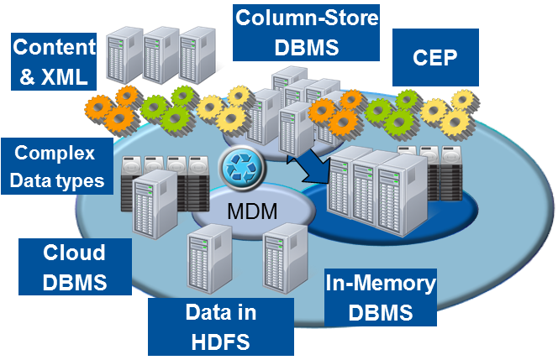
Shift from a Single Platform to an Ecosystem
"Logical" Data Warehouse
“We will abandon the old models based on the desire to implement for high-value analytic applications.”
Notes:
Gartner recognizes the requirement to use multiple diverse systems to provide a complete analytical environment also. They talk about the Logical Data Warehouse including many types of systems and technologies to provide a comprehensive analytical environment for an enterprise.
***************
Industry research shows the shift from a single system to an ecosystem where different technologies can unify and process data in the most efficient and specialized way to add the most value
Gartner calls this movement the “logical data warehouse” which is being driven by a “desire for high-value analytics”
EMA and 9sight research shows that, on average, most companies tackle big data with 3 systems including “analytic databases, discovery platforms, and NoSQL solutions” (more details below)
===============
When asked how many nodes (nodes refers to a separate system/DB in their architecture) were part of their Big Data initiatives, the EMA/9sight survey respondents indicated that a wide number of Hybrid Data Ecosystem nodes were part of their plans.
The most common answer among the 255 respondents was a total of Three Hybrid Data Ecosystem nodes as part of the respondents’ Big Data Initiatives, showing that Big Data strategies are not limited to a single platform or solution. When the Two to Five Hybrid Data Ecosystem nodes indications are aggregated, over two thirds of respondents are included in this segment. This shows Big Data Initiatives are focused on more than just a single platform (e.g. Hadoop) augmentation of the core of operational platforms or the enterprise data warehouse. Rather, Big Data requirements are solved by a range of platforms including analytical databases, discovery platforms and NoSQL solutions beyond Hadoop.

Slide 4
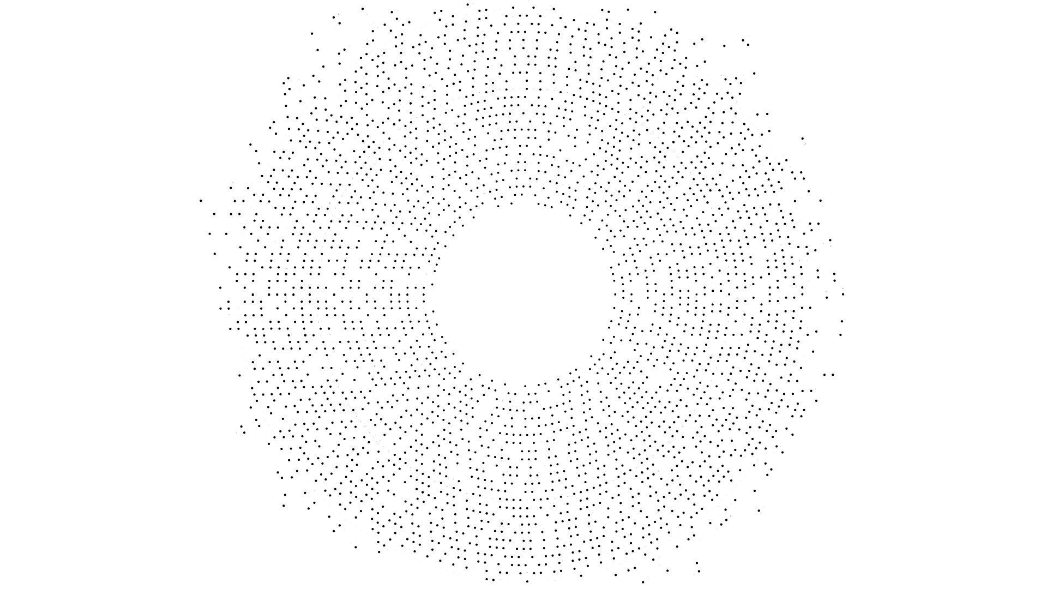

Data Distribution in an Ecosystem – Siloed by Domain
FINANCE
OPERATIONS
Telemetry
ELECTRONIC COMMERCE
RFID
SERVER LOGS
Maps
Orders
Revenue
Expenses
Inventory
Returns Manufacturing Supply Chain Customer Service
IVR Routing
SENSOR
SOCIAL MEDIA
2855
Case History
CUSTOMER EXPERIENCE
CUSTOMER CARE – AUDIO RECORDINGS
Customers
Campaign History
Customers
Products
Pipeline
EXTERNAL INTERACTIONS
DIGITAL ADVERTISING
CUSTOMER PORTAL INTERACTIONS
CLICKSTREAM INTERACTIONS
MARKETING
RATINGS & REVIEWS
SALES
Accurate analytics require integration of data across your ecosystem
© 2015 Teradata

Slide 5
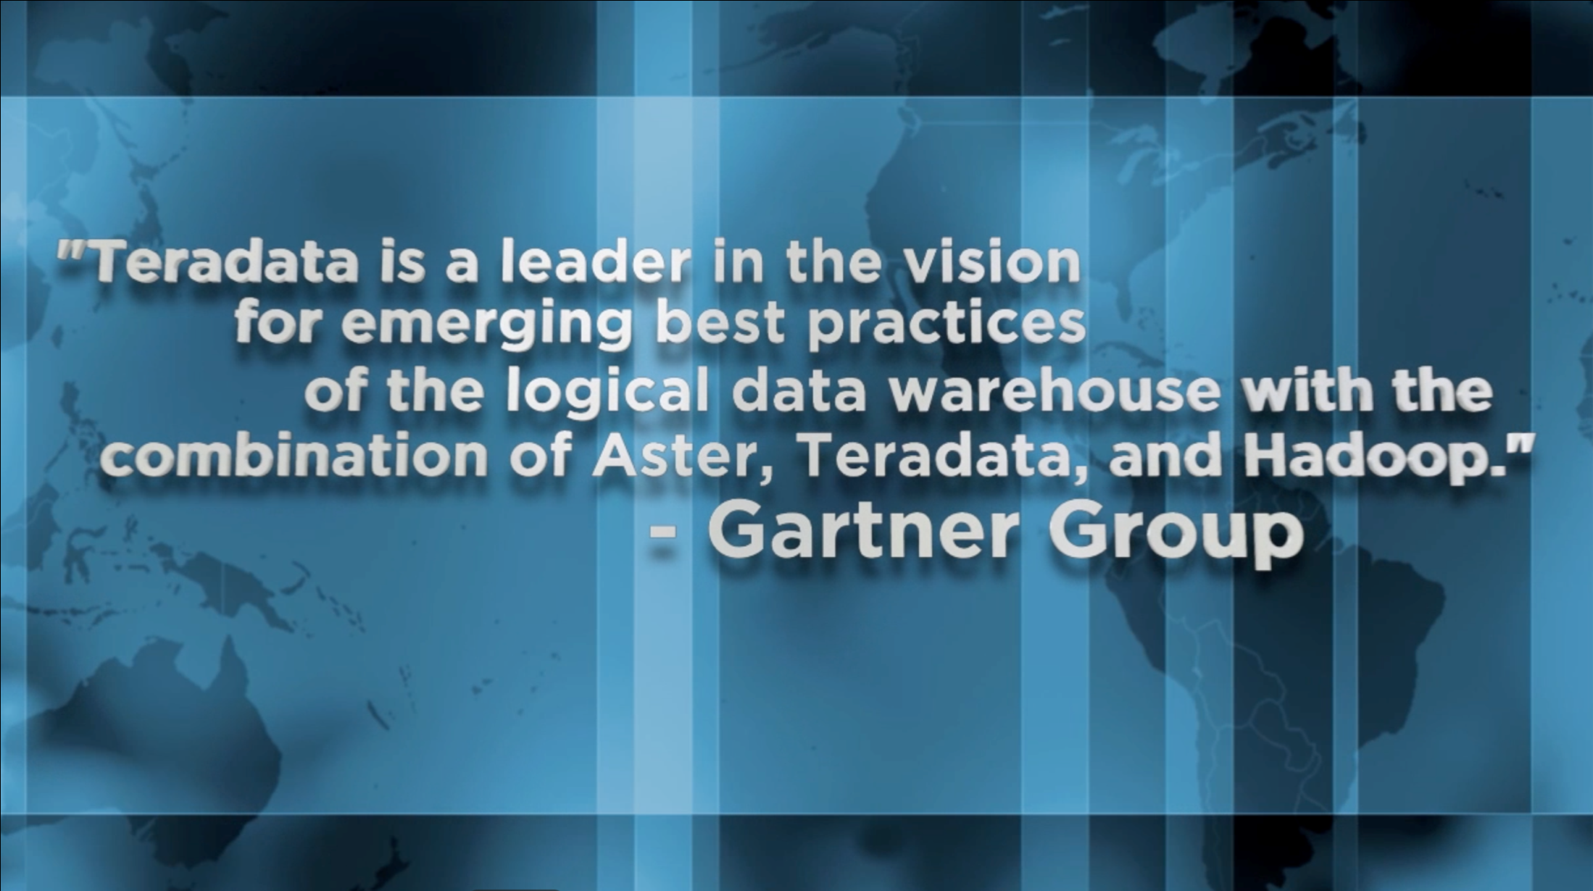
Notes:
We strongly believe that our vision is right and we have a great opportunity to lead the market with our Unified Data Architecture and again competitive advantage.
Gartner acknowledges that Teradata is a leader in implementing this architecture, but we’re not stopping here.
We’re introducing our Teradata QueryGrid with Teradata 15 to take our Unified Data Architecture to the next level with more integration and optimization between the various compute engines in the UDA.

Slide 6
Teradata UDA解决方案介绍

Slide 7
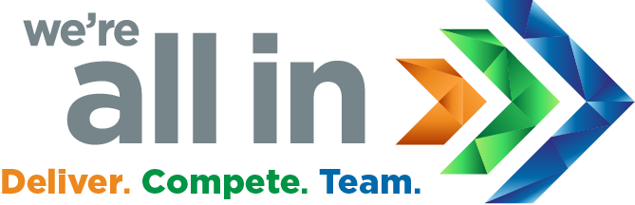
Sources
Acquisition
Data Engines
Analytics
Access
Users
REAL TIME
Audio and Video
Marketing Executives
NO SQL
MULTI GENRE
DATA LAKE
DATA LAKE
APP FRAMEWORK
Sensors
Operational Systems
VIRTUAL QUERY
OPERATIONAL
Text
INGEST
Customers Partners
EMERGING
Web and Social
IN MEMORY
Knowledge Workers
DATA WAREHOUSE
Business Intelligence
DATA WAREHOUSE
Machine Logs
COMPUTE CLUSTER
CONVENTIONAL
Languages
Business Analysts
crm
Integrated
Development
Environment
Data Scientists
scm
Platform Services
DATA
DEVELOPMENT
OPERATIONS
erp
Cloud Deployment
PUBLIC
PRIVATE
HYBRID
Engineers
© 2017 Teradata

Slide 8
Sources
Ingest
Prepare
Consume
Users
GOVERNANCE & SECURITY
Audio and Video
Data Storage Types
Analytic Techniques
Marketing Executives
RELATIONAL DATABASE
QUERIES, REPORTS, DASHBOARDS
VISUALIZATION FUNCTIONS
Sensors
Operational Systems
DISTRIBUTED FILE SYSTEM
KEY VALUE STORE
Text
PATH & PATTERN
GRAPH
Customers Partners
Web and Social
STATISTICS & MACHINE LEARNING
Knowledge Workers
DOCUMENT ORIENTED
GRAPH DATABASE
TIME SERIES
Machine Logs
Business Analysts
WIDE COLUMN STORE
CONTENT ANALYTICS, SENTIMENT EXTRACTION
crm
Data Scientists
scm
erp
Metadata
Engineers
OPERATIONAL
</>
TECHNICAL
BUSINESS
© 2017 Teradata

Slide 9








UDA之核心技术-Teradata QueryGrid™
Entry Points
TERADATA Database
Aster Analytics
Presto Hadoop
Targets
TERADATA Database
Aster Analytics
Presto Hadoop
Hive / HDFS
Hadoop
Other Databases
NOSQL
DATABASES
Integrated Data Warehouses
Multi-Genre Advanced Analytics™
Multiple Hadoop SQL Query Engines and Distributions
3rd Party Relational DBs
Non-Relational DBs
Presto
Connectors
Teradata Certified
Community Supported
MySQL
Postgresql
Amazon S3
APACHE CASSANDRA
APACHE KAFKA
PRESTO API

Slide 10
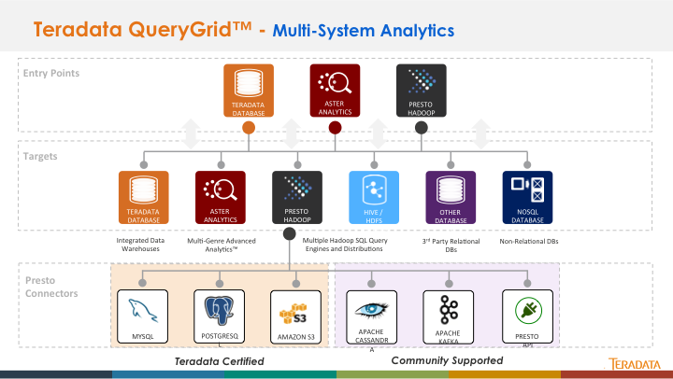
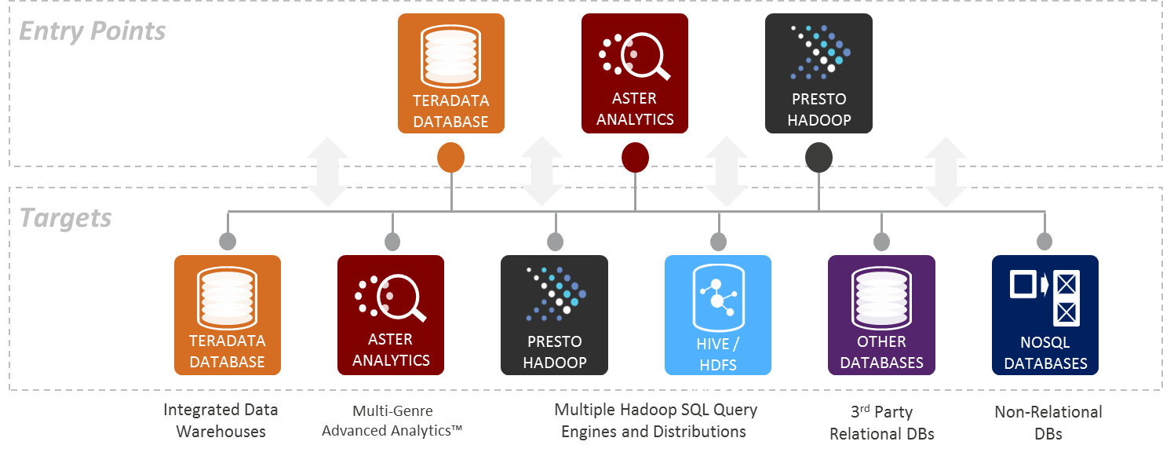
Data Fabric Enabled by QueryGrid™ Analytic Flexibility to meet your business needs
Users direct their queries to a cohesive data fabric using existing SQL skills & tools
Pick Your Best-of Breed Technology:
Data types
Analytic engines
Economic options
Run the right analytic on the right platform:
Minimize data movement, process data where it resides
Minimize data duplication
Optimized work distribution through “push-down” processing
Bi-directional data movement
Focus on data and business questions, not integrating separate systems
Notes:
We like to call this seamless multi-system environment the ‘Data Fabric’
Customers get the analytic flexibility to meet their business needs by picking the best of breed technologies that fit their needs
Different systems have different strengths and uses at different price points, so there are many considerations that businesses take into account such as
Workload and data characteristics, CPU / I/O usage, availability and service level agreements as well as economic constraints
Run the right analytic on the right platform
Take advantage of specialized processing engines while operating as a cohesive analytic environment
Using a consistent interface using SQL so that you can leverage your existing tools and skillsets
QueryGrid allows them to focus on data and business questions and not the difficulty of integrating the separate systems

Slide 11
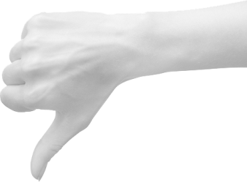

QueryGrid不是什么和是什么
DTG
QueryGrid不是什么:
A substitute for integrating data in the warehouse
A general purpose data virtualization platform
An automatic cross system optimizer
A performance enhancement for remote systems
QueryGrid是什么:
Seamless, high-performing data access, processing and movement
High Performance multi-system analytics
Easy self service SQL interface
Parallel bi-directional data movement

Slide 12
QueryGrid 2.0功能特性
Higher Performing, Higher Concurrency architecture
All enabled query engines can initiate data access
Universal feature set provided by all connectors
Includes an expanded feature set
Transport
Socket Pools
Wire Protocol
Compression *
Throttling *
Routing
Network Selection
Skew avoidance
Bridge support *
Redistribution *
Security
Authentication
Encryption
Administration
Centralized Configuration
Automated Installs
Zero-down time Upgrades
DevOps
Monitoring
Health Checks
Performance Monitoring
Alerting
Troubleshooting
Centralized Logging
Diagnostic Checks
*Future

Slide 13
Teradata UDA客户案例

Slide 14
QueryGrid 行业应用案例
行业客户 | Teradata | Aster | Hadoop | 应用领域
车辆制造 | X |  | X | 数据桥接
通讯 |  | X | X | 工作流分析
金融 |  | X | X | 合规/安全
旅游 | X |  | X | 流并行处理
计算机制造 |  | X | X | 精准营销
电信运营商 | X | X | X | 数据探索
电子商务 | X |  | X | 网站搜索
金融系统提供商 | X | X | X | 差旅及网络会议
电子元器件制造 |  | X | X | 过程控制
Notes:
This table gives an indication of the platforms involved in a QueryGrid workload at the customer installation.
The study was aimed at showing QueryGrid in action, primarily with Teradata and Aster connectivity to Hadoop. However, some sites used the Aster QueryGrid to Teradata connectivity as well. There are also examples of QueryGrid connectivity between Teradata and Oracle (Unity Source Link is now part of QueryGrid). This research did not look into those implementations.
We should point out that sometimes the X in the Teradata columns is because Aster is using QueryGrid to fetch data from the data warehouse. In this case, Aster consolidates data from Hadoop and the data warehouse and then applies analytics. In these cases, Teradata Database is NOT accessing Hadoop or Aster with Querygrid.
In the next year, we will add more platform columns as new QueryGrid options arrive such as Teradata to Teradata and Teradata to MongoDB

Slide 15
QueryGrid应用场景案例
行业客户 | 场景 | 成熟度
车辆制造 | 维护目标识别 | 日常应用
 | 识别过度保养 | 原型
通讯 | 提高客户保有量 | 日常应用
金融服务 | 监控经纪业务合规 | 生产上线
 | 网页日志序列化 | 原型
旅游 | 网络日志渠道用户转化 | 日常应用
 | IVR呼叫中心日志用户转化 | 原型
 | 提升网页设计及A/B测试 | 日常应用
计算机制造 | 从客户浏览日志识别潜在客户 | 日常应用
电信运营商 | 减少客户流失 | 日常应用
 | 呼叫中心仪表盘之客户满意度 | 原型
电子商务 | 提升站内检索 | 生产上线
金融系统服务商 | 降低差旅费用支出 | 生产上线
电子元器件制造 | 监控过程质量 | 原型
Notes:
Production means the use case is in full production, typically automated with batch job scheduling and usage by the business or engineering community
Daily use means that the users invoke QueryGrid when they need it which may be several times a day but not necessarily everyday. This is especially common with data science exploratory analysis.
Prototype means the customer was working on this project when they were being interviewed. This workload may or may not go into production or daily use. Its shown to give an indication of interest by the user community.
Note that the term “production” is ambiguous in a discovery environment. In some situations, a discovery or exploratory environment is used as needed or on demand. This is in contrast to passing through a quality assurance process and the workload being handed off to the data center operations staff to run in batch or similar modes. Discovery environments by their nature are often self service interactive workloads.

Slide 16
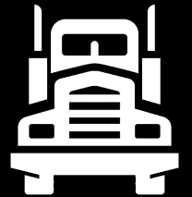
Vehicle Manufacturer
INTEGRATED DATA WAREHOUSE
Problem
Predicting machine repairs using sensors
Business and Engineers disconnected
Challenge
Get more value from the sensor data
How to get data to SQL tools and users?
Results
QueryGrid provides the bridge between cultures – now they collaborate!
Business Analysts
Teradata
Database
Query Grid
DATA PLATFORM
Engineers &
Programmers
Hadoop
Notes:
The company manufactures and operates large complex vehicular equipment with critical life and safety issues. The equipment is highly computerized with sensors monitoring every aspect of its operation. Sensor readings stream back to the company in batches throughout the day.
A typical vehicle generates a few megabytes per day with several thousand data items, which is stored and maintained for about $1,000 per year. The sensor data is stored in HDFS cluster, which enables low-cost access to the entire sensor history. The problem was “getting answers from the sensor data in a timely fashion” to improve the operation of that equipment.
The first use case was the daily maintenance of the equipment. By monitoring whether the sensor readings were within specified limits, the company could identify specific components for repair or replacement. However, the company realized that the potential was far greater, spanning many functions, such as failure predictions, accident investigations, long-term maintenance strategies, design testing, and operational efficiency. This was no longer a single-purpose application, but the beginning of an evolving infrastructure with impacts across their business. Hadoop people were happy doing their MapReduce stuff while the IT people were happy doing SQL.
Although the Hadoop platform supported a variety of processing using Pig, Hive, and MapReduce, specialized skills required and complexity of coding limited the number of users accessing this platform. Further, the analyses required blending other reference data (such as equipment schedules, staffing) that was constantly changing and maintained on the Teradata data warehouse system.
The corporate IT staff and Hadoop developers needed to apply their distinct capabilities and collaborate to solve the larger issues of sensor analysis. These were two cultures with different skill sets, project timelines, management reporting lines, and degrees of urgency. The Hadoop people were “happy doing their MapReduce stuff” while the IT people “were happy doing SQL”. But some type of bridge was required between the infrastructures and the two cultures. One solution would be to extract sensor data from HDFS and load it into the data warehouse. However, the data volumes and query diversity made this approach cumbersome.
About this time, Teradata released system-to-system connector called SQL-H, which provided a bridge between the two cultures and resulted in a “more natural” work environment. Moreover, this bridge provided the basis for collaboration. If the SQL queries produced datasets that were too large, data on Hadoop is reorganized to be more selective during a QueryGrid request.
The SQL OVERLAP and INTERSECT temporal extensions on the Teradata platform enabled a simple way to dissect complex time overlapping of sensor data, which is otherwise error prone. In addition, temporal compression achieved dramatic efficiency improvements, opening up new analysis opportunities for the company.
The second use case is detecting unnecessary maintenance. The company found a high percentage of “false positives,” which caused vehicles to be serviced unnecessarily, thus increasing operational costs. The company is now better with their sensor analysis, reducing unnecessary maintenance costs.

Slide 17

Communication Provider
Business Analysts
INTEGRATED DATA WAREHOUSE
Discovery platform
Problem
Churn analysis of consumer journey
Enormous data volume
Challenge
SQL not for event sequence analysis
Analysts use SQL, can’t write Java
Results
Aster direct Hadoop access + nPath simplifies customer journey analysis
Teradata
Database
Aster
Database
Query Grid
DATA PLATFORM
Business Analysts
Hadoop
Notes:
This company supplies communication services. The use case for QueryGrid is to improve customer retention by understanding customer behavior, such as when customers have negative experiences with their services. There data volumes was growing like crazy, over 50B records a day from one source. All the customer touch points were too much data to be managed cost effectively within the Teradata data warehouse, so the company moved this data to HDFS. Their approach was to “store the data where it belongs and process the analytics where it belongs.” QueryGrid connected the three platforms as a “marriage of relational data to nonrelational data.”
The company started “bringing in new data sources that they never thought they would retain” by adding Hadoop storage. The data initially consisted of a few billion rows per day of company website logs, plus demographics and billing history. However, this data provided “a narrow view” of the customers. The company expanded data collection to incorporate many other web-based sources.
Event sequencing analysis (aka the golden path query) was difficult to perform with standard SQL that required many complex self-joins. The Aster SQL MapReduce using the nPath function enabled the company to answer quickly event-sequencing questions like: What steps does the customer do prior to using or buying our products? What is the last step that the customer performs before going away from our website? What are the steps leading up to a purchasing decision? The company now has the ability to “analyze all these things at once, which is very important” for understanding customer behavior.
The Aster platform pulls weblog data from Hadoop and “marries” it with billing data from the Teradata data warehouse. The SQL-MR job on Aster initiates the QueryGrid transfer from Hadoop into a temporary or permanent table. It then performs the MapReduce processing on Aster. “The flexibility is great!” The company is able to paint the entire customer journey in using their product and services.
The company felt that Teradata QueryGrid will “get rid of a lot of busy work for their data scientists.” The latest version allows MapReduce jobs to be pushed down to Hive on Hadoop so that only filtered results are transferred back to Aster. Since the data volumes are huge, this filtering is a huge advantage in performance.
The users of QueryGrid are business-oriented data scientists who prefer “higher level tools rather than getting into the weeds.” These users are not “Silicon-Valley hard-core coders” but practical analysts who are “more interested in solving the business problem than creating elegant engineering projects.” They will use “whatever tool to get the job done, taking the easy route. Time required to generate analytic results matters.” “Teradata QueryGrid will get rid of a lot of busy work for their data scientists. “
Aster pulls in web log data and combines it with the billing system data. If a customer has a billing dispute and clicks around the website. Aster contains some of the transaction data from a Teradata system.

Slide 18

Financial Services
Business Analysts
INTEGRATED DATA WAREHOUSE
Discovery platform
Problem
Brokers overstating financial returns
Government audits and $$$ penalties
Challenge
Text analysis of Outlook emails
Investigate possible violations
Sessionize interactions
Results
50% reduction in false positives
Reduced labor reading emails
Teradata
Database
Aster
Database
Query Grid
DATA PLATFORM
Business Analysts
Hadoop
Notes:
The company provides consumer and commercial financial services. Over the years, the company’s IT infrastructure has grown to over a petabyte of data managed among the Teradata, Aster, and Hadoop platforms. It’s a sales brokerage compliance application in a heavily regulated industry. Any communications to customers -- in this case email -- has to be audited to be sure that the brokers are not over promising financial results to clients. There are over 2500 rules regarding statements that suggest improper behavior. Previously it was an all manual process with a lot of false positives. It took 50 people on shore, 250 offshore scanning emails, manually. Furthermore, the company has to set aside up to $50M in reserves in case a lawsuit occurs. And failure to provide thoroughly audited proof of broker behavior can cause the government and Securities Exchange Commission to levy steep fines in the millions of dollars.
The Aster team took their rules and had an offshore contractor write them in Perl. The team also created an Outlook.PST map-reduce function to parse emails.
What makes this challenging is the back and forth communications between people such that one email thread gets longer and longer. One thing we did was reduce the extensive text (signature lines, repetitive text). The customer dumped all broker email into Hadoop. They cleaned up the emails using Hadoop. They then use Aster SQLH to run the filtering algorithm pulling the data set from Hadoop where the remaining rules are applied. This reduced false positives 50%.
The daily volume is 2.3M email messages a day. 50TB per year.
When the bank use requests information, Aster uses SQLH to pull data from Hadoop. Aster refines the data and uses QueryGrid to send the data to the Teradata Data Warehouse. The data warehouse displays the final dashboard is displayed. Some of this involves batch scripts.

Slide 19

Travel Services
INTEGRATED DATA WAREHOUSE
Problem
Conversion funnel of lookers to bookers
How best to spend Marketing funds?
Challenge
Correlate weblogs and call center IVRs
Results
Data placement on Hadoop
Sessionize consumer interactions
Calculating A/B testing to increase sales
Business Analysts
Teradata
Database
Query Grid
DATA PLATFORM
Programmers
Hadoop
Notes:
The travel reservations company has three use cases for QueryGrid. The first two involve conversion funnels for the website and for the call center, while the third use case involves improving customer experiences on the website using A/B testing.
Customer journeys to the company’s website can start at many locations, such as Google, meta-search, and sales affiliates. There are then further touches (clicks) from customers as they move through the website, such as categories within the site, search within categories and the like. These various paths may or may not be fruitful for the customer. Some customers will eventually book a travel service, and a transactional system of the company will capture the booking data.
As customers funnel through the company’s website, the company’s goal is to determine how customers convert from browsing to purchasing, which is referred to as the conversion funnel. To do so, the company must analyze two datasets. The first is behavior data from website logs and web analytic vendors. The second is the bookings captured by transactional systems. The first use case for QueryGrid involves the conversion funnel using the website logs, so that the company can answer questions such as “Where should we spend marketing funds to improve website bookings?”
Web logs contain a significant amount of data that needs to be parsed to assess the unique customer journey for every customer visit. Hadoop is useful for this kind of processing. The bookings data is contained in ERP systems and transferred regularly into the Teradata data warehouse. Therefore, QueryGrid brings the finalized customer journey data from Hadoop into Teradata to be combined with the bookings data, showing which customer journeys convert to revenue contributions to the business.
The second use case also involves the conversion funnel but using data from call centers in the form of IVR datasets, which are complex sequences of text and audio. The IVR data is also stored on the Hadoop platform. QueryGrid is used to combine the booking data with the IVR journeys to determine conversion contributions from customers.
The third use case for QueryGrid involves the support of A/B testing for improving website content design. The company is constantly testing new ideas for website content and style, such as listing travel alternatives to page layouts and special offers. Every day, the company assesses the impact of dozens of website changes observed by randomly selected customers.
Experimenting with hundreds of QueryGrid data streams running over night, which they deemed to be unbelievably cool.
On the Hadoop platform, the A/B testing team tracks each website change within the click stream data. Throughout the day, QueryGrid is used to transfer booking data from the Teradata platform to the Hadoop platform. The team matches the two datasets to calculate metrics (like dollar volume) for each test.
The company realizes that they are just beginning to leverage the synergism of Teradata and Hadoop platforms. They are experimenting with hundreds of QueryGrid data streams running over night, which they deemed to be “unbelievably cool.” Customer behavioral data from various sources is growing rapidly on the Hadoop platform. The company is not trying to integrate data within Hadoop, but they are experimenting with evolving that data into productive business applications.
The company recommends being “careful and thoughtful” about synchronizing data movement among platforms and optimizing processing where the data resides, thereby minimizing the data movement. However, users should access data through the platform that they prefer, striking a balance between the value propositions of data storage to analytic processing among the various platforms.

Slide 20

Computer Manufacturer
Discovery platform
Problem
Track customer website journey
Challenge
Hadoop security limitations
“Everybody has BI tools”
No Java or Map reduce skills
Results
Identifies 66% of visitors, up from 33%
Enhances propensity models
Improved marketing campaigns
Batch scoring every 2-3 months → near real time
Business Analysts
Aster
Database
Data
Scientists
Query Grid
DATA PLATFORM
Hadoop
Notes:
The company manufactures a variety of computer systems. Their use case for QueryGrid was to understand the customer journey through their website with a 360-view of buyer behavior. The benefits are primarily in lead generation, which are used by the sales organization. The company operates Hadoop, Aster, and Teradata platforms, all of which are InfiniBand™ connected for performance. Omniture click streams go to Hadoop where there is a little data conditioning, then the data is pulled into Aster. Aster also pulls in Teradata data. They are trying to answer “What are the last 5 customer events on the website? Why did they leave? How many emails were sent and then which of these affected an action by the consumer? Aster then does production reporting and Excel spreadsheets output. Hadoop collects 18 months of data which is 50TB compressed. Purged after 2 years. The application started development in December 2013; ingest took a month. Aster took 2-3 months of development then went into production April 2014. There was a lot of concern about Hadoops lack of security. Consequently they built several layers of views in Aster. This lets them lock down the QueryGrid connector to Hadoop so only some users can access it. They only have 1-2 data scientists with direct access to Hadoop.
The weblog clickstream data is stored in HDFS on the Hadoop platform. Customer data is collected via SalesForce.com for the Teradata platform. The Aster platform collects the relevant data from these two platforms, analyzes and shares the results using the Aster Lens visualizations, along with Excel downloads for final end users. The company used this arrangement because it “was faster than moving all the data to the Teradata platform.”
The company uses QueryGrid via SQL base-views that hide the HDFS configuration to protect the data since Hadoop lacks adequate security. Upon the base-views, transform-views perform the required data transformations to feed the Aster analytics.
They are expanding its use of Aster analytics, particularly with weblog sessionization, Aster nPath event tables, and eventually graph analysis. There are use cases for the Teradata-to-Hadoop which they will pursue mid-2015.
Before using the Teradata Aster discovery platform marketing could identify only 33% of respondents, and relate that to their propensity to buy. Now, customer identification, increases to 66%, driving it back to an email address. That additional information enhances propensity models and makes future campaigns more successful.

Slide 21
Telecommunications
Business Analysts
INTEGRATED DATA WAREHOUSE
Discovery platform
Problem
What are the steps to canceling service? How many steps until they cancel?
What step is the customer in right now?
Challenge
Analyzing 20+ data event streams
Results
Call center 360⁰ customer dashboard
Less churn and termination fees
3-6 month projects now done in 3 days
Query Grid
Teradata
Database
Aster
Database
Query Grid
DATA PLATFORM
Business Analysts
Hadoop
Notes:
The company is a telecommunication firm that is focusing on a complete 360-degree view of their customers. The company has two related use cases for SQL-H: customer churn and customer satisfaction index. In both use cases, the Aster Discovery Platform is used for analytics. QueryGrid is “the quickest and easiest way to “peek at the data every day”. Every day, production batches using SQL table operators refresh tables on Aster from the raw data on Hadoop. In addition, several power users submit ad hoc queries to pull, refine, and play with data for new analytic applications, which eventually are put into production if proven useful. Results generated on the Aster platform are shared among analysts using Tableau, Aster Lens, and Excel. With Hadoop, they access and link pre- and post- billing data, engineering data and clickstream data.
The first use case focuses on reducing customer churn switching to competitors, which includes improving the network quality of cellular signals that may cause churn. This effort requires detailed data gathered from various external systems and stored on the Hadoop platform. Currently Hadoop acts mainly as a large HDFS file store, with little MapReduce processing.
The second use case is a customer satisfaction dashboard for use in their call centers. The purpose is to improve customer retention and up-sell options. This use case is interesting because it is compiling a great variety of data from more data sources.
QueryGrid pulls about twenty data sources into Aster from both the Hadoop and Teradata platforms, refreshing a hundred million rows of data. The company notes “performance has been good.” The business value of QueryGrid is its ability to ingest data into Aster Discovery Platform for analysis. The company notes, “The level of effort is really low once you understand how QueryGrid works.”
Since Aster acts as “a massive analytic sandbox,” the company is able to perform rapid prototyping of new applications with new datasets. The Teradata Database platform is “locked down,” but it contains “the crown jewels data” needed for new application development. In contrast, the Hadoop platform can “ingest all that messy new data.” The Aster platform sits in the middle, using QueryGrid to fetch data from both the Teradata Database platform and the Hadoop platform. Projects like the second use case previously “took 3-6 months, but now similar projects are taking 2-3 days” to ingest and analyze the data, all with greater functionality and stability. Reports are provided by Aster Lens and Tableau.
Capturing account memo data and sessionizing them proved successful too. They accessed interactions in 60-minute zones, and within those 60 minute zones, there were multiple customer sessions usually worth further examination. For example, did a customer just buy a mobile phone and call a customer service agent trying to activate? What if the customer called multiple times, continually being transferred without their problem solved?

Slide 22

eCommerce
Business Analysts
INTEGRATED DATA WAREHOUSE
Discovery platform
Problem
Improving website search for online customers
Challenge
Using Hadoop for text mining of EDW data
Bring analytic results back into EDW
Results
Allow analysts to do the things they are best at on their preferred platform
Query Grid
Teradata
Database
Aster
Database
Query Grid
DATA PLATFORM
Online
Customers
Hadoop
Notes:
The eCommerce company focuses on improving the effectiveness of online customers to find and purchase products matching their needs. The Teradata database system supports their enterprise data warehouse (EDW), which encompassed most of their business functions, while a separate appliance-based Hadoop platform supports behavioral analytics.
The company was an early adopter of the Hadoop platform, which was initially for “skunkworks projects focused on unique hard problems that were considered unsolvable through existing technology solutions.” Over a few years, the company gained confidence in the Hadoop platform and blended it with their mainstream IT infrastructure.
The early applications that used the Hadoop platform often required most of its data from the EDW. Hence, an early requirement was to move data in both directions between Hadoop and Teradata platforms. This is different from typical Hadoop adopters who compile massive datasets from website click-streams and generate small result sets to be transferred to their EDW.
One application took text data from the EDW, performed text mining on Hadoop, and returned results to an external search provider. Later, other applications transformed data and moved results back to Teradata. The motivation for these was mainly for cost savings by reducing the Teradata workload. The policy was “high value jobs on high cost systems,” implying analytical use cases had higher value than data preparation use cases. More recently, there is blending of the platforms so that “users are allowed to do the things they are best at” on their preferred platform.

Slide 23

Financial Systems Provider
Business Analysts
Data
Scientist
INTEGRATED DATA WAREHOUSE
Discovery platform
Problem
Containment of employee travel costs
Challenge
How to correlate phone calls, travel, and Webex use by employee?
Results
Training classes for high travel low Webex use employees drops travel costs
Also condition based maintenance analysis of installed machines
Teradata
Database
Aster
Database
Query Grid
DATA PLATFORM
QueryGrid
Hadoop
Notes:
The company manufactures, installs, and services ATMs, POS devices, and kiosks worldwide. To perform these activities, employees are required to travel for visiting customers, servicing equipment, and coordinating with colleagues. For many years, the company has tried to reduce these travel expenses (along with unproductive time on airplanes) with telepresence video conferencing and WebEx desktop sharing. They showed that, in many situations, travel expenses could be reduced with virtual meetings, without affecting business performance.
The use case for QueryGrid is to identify who-interacts-with-who within the company, correlate with travel events, and generate reports about actual/potential cost savings from virtual meetings. These reports were referred as ‘guilt trip reports’.
A Hadoop platform collected detail call/message data at the IP phone-address level. The Aster platform did the initial analysis using the Aster analytics package (especially the nPath function) plus Tableau for visualization. Once the analytics team identified interesting results, management disseminated the ‘guilt trip’ reports on the Teradata system via Business Objects reports. Hence, QueryGrid was utilized twice to extract data from Hadoop, initially from Aster and then from Teradata. In both situations, the use of QueryGrid could be hidden from the users of Tableau and Business Objects with SQL views so that Hadoop appears as a local database table.
Finally, the company admitted that this was an ad hoc application initiated “just to see if we could do it”! This is an example of the thousands of new analytic-based applications that are possible with current analytic tools “…if we nudge ourselves to think creatively.”
Actual call data is dumped in Hadoop. It was an excuse to play around with Hadoop. They started with the telephone switch data which is high volumes of data.
They join the IP addresses of emails with the org charts to see who calls internally and externally. You look at it by region and other perspectives. Then you overlay your travel costs on that. The places people call the most often are usually where they fly to. Some groups always travel and rarely call. So a lot of slicing and dicing was needed to find something useful. When they did a stack ranking, they could see which group of employees has the highest travel costs. Surprise -- those guys never use Webex, they use airlines instead. The people with the lowest travel costs use WebEx constantly. So they find the top 10 and spend some time training them.

Slide 24

Electronics Manufacturer
INTEGRATED DATA WAREHOUSE
Problem
Yield management, manufacturing equipment fault detection
Slow identification of root cause and fix
Challenge
Huge sensor data volume → Hadoop
Difficult to get Hadoop reports to users
Results
Protoype → production in 2015
Unit level traceability
Quality root cause analysis
Engineers,
Plant workers
Finance,
& Analysts
Teradata
Database
Query Grid
DATA PLATFORM
Programmers
Hadoop
Notes:
Globally they were collecting data in Oracle data marts for Yield Management and Manufacturing Equipment Fault Detection. Lack of unit level traceability to rapidly link product test data with manufacturing process data for process optimization, product cost entitlement and field quality root cause/exposure analysis made it difficult to efficiently achieve and maintain cost/ Gross Profit Margin targets.
The electronics manufacturing company focuses on detecting potential failures in their manufacturing process. Based on hundreds of second-by-second sensor readings, they want to predict when product quality will exceed its limits, so that they could quickly stop the assembly line and correct operating parameters on manufacturing equipment.
The company was collecting sensor data but only a selected subset. They felt that, if they could apply analytics to all the data, their failure detection would improve. The company has been prototyping a Hadoop platform to collect all of the sensor data (over ten gigabytes per hour per assembly line) within HDFS. Their Hadoop prototyping proved that they could collect all the sensor data without problems. However, it was difficult to extract the data out of the Hadoop platform within their requirement for fast response times.
After proof-of-concept testing with several vendors, they decided to acquire a Teradata 2750 Data Warehouse Appliance and use QueryGrid to extract the data from their Hortonworks Hadoop platform over a 10 Gb network. The 2750 will be used to analyze the sensor data and to generate reports and dashboards to a wide spectrum of business users throughout the company.

Slide 25
UDA Demo环境演示
Notes:
Alternate divider slide

Slide 26

我们坚信…
分析和数据将会释放伟大企业的潜力
Notes:
We believe that analytics and data unleash the potential of great companies.
Analytics and data have become the number one assets in organizations that are driving differentiated value. When companies treat analytics and data as their number one asset, they have the now have the ability to transform organizations.
Whether your company is working to:
Reduce the time for clinical trial for new drugs;
Improve yield for farmers by better managing soil and crops
Lower carbon emissions; or
Improve communications between people
… there is unlimited potential to what data and analytics can unleash.

Slide 27
Notes:
Closing slide for all presentations

